Slide 1
Network of Institutions and Leaders for Future Generations
2023-2027 Strategy

Slide 2
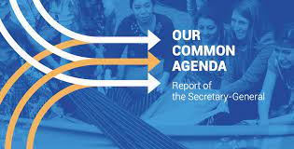
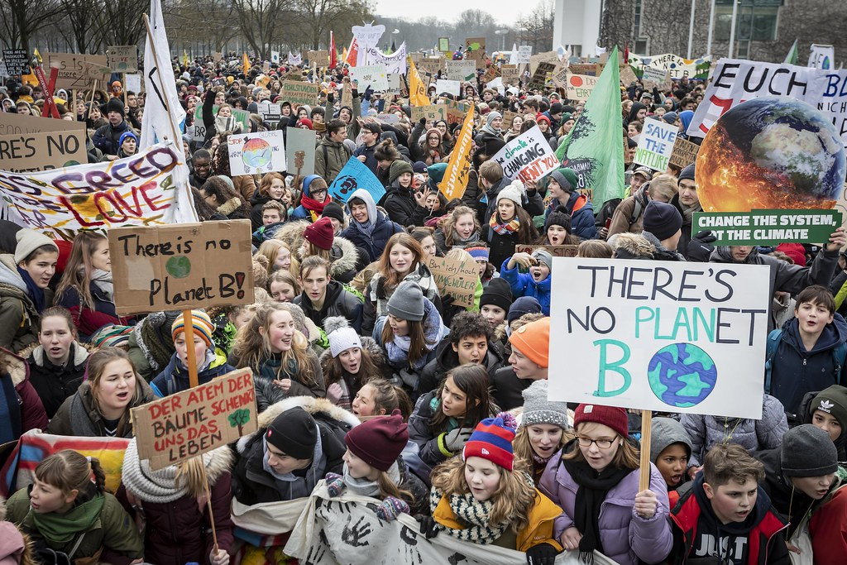
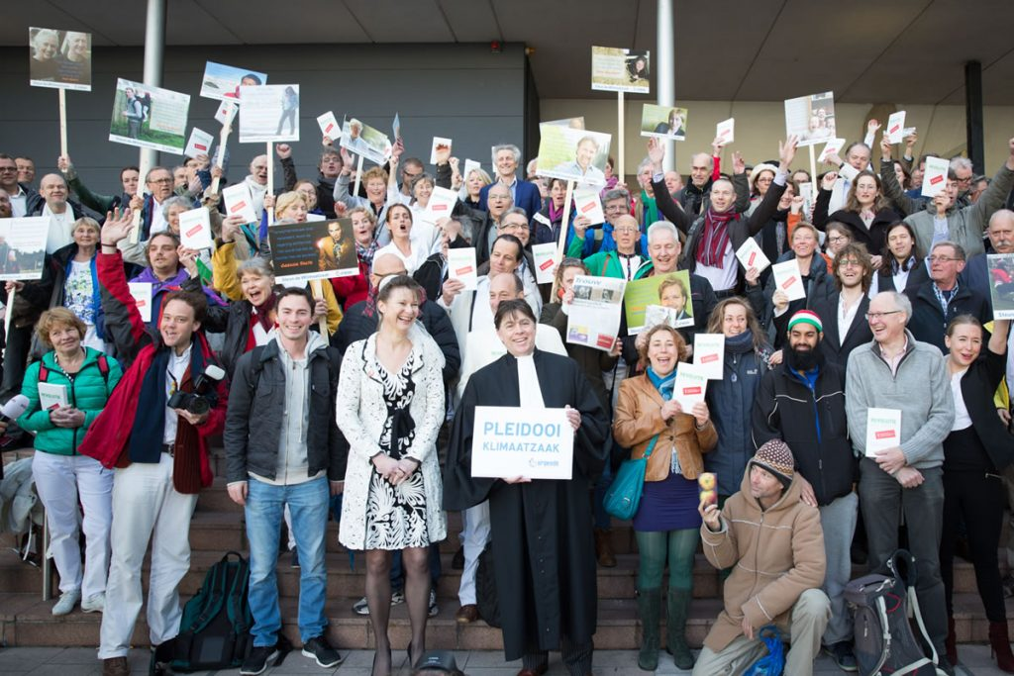
Increasing global ecosystem of future generations governance
The Network of Institutions for Future Generations has existed since 2014. With key developments in the last years, it was time for a refresh of the strategy and approach of the Network. The following slides outline this strategy for 2023-2025.
Multi-level Governance
Non-governmental Actors
Legal Landscape
Activism & Young people

Slide 3
Background
The Network of Institutions for Future Generations, NIFG (The Network) was established in April 2014 in Budapest, Hungary, originally under the name of Roundtable of Institutions for a Sustainable Future.
In 2023, the Network change its name to the Network of Institutions and Leaders for Future Generations (NIFG) in order to align with its vision and mission, and to better capture the membership composition.
What is it:
NIFG is an independent international network encompassing national institutions, organisations and leaders working to ensure the rights, interests and well-being for future generations within the ambition for sustainable development.
Vision:
We envision a world where future generations’ rights, interests and well-being are present in governance frameworks and international decision-making.
Mission:
To build a global movement that represents the diversity of organisations, institutions and leaders working to attain NIFG vision.

Slide 4
Core Activities of NIFG
The Network of Institutions and Leaders for Future Generations focuses on the following:
To be a thought leader on the key decisions for future generations governance and interests.
To be the voice of organisations, leaders and institutions of the Network.
To maintain and extend collaboration with the UN and other international fora.
To influence and shape a global movement to champion the interests, rights and well-being of future generations, with sectors and stakeholders, including young people.
To share knowledge and learning from experience within the Network and the broader global movement

Slide 5
Strategic Objectives
Movement & Momentum: Diversify and grow the membership of the Network to represent a global movement working towards NIFG’s vision
Thought Leadership & Influence: Influence and inform key developments in international processes and other contexts to ensure future generations are taken into account in policy and governance.
Implementation & Impact: Build legitimacy and knowledge through shared knowledge, peer support, and examples of impact and success to support the movement working towards NIFG’s vision.

Slide 6
Objective: Momentum & Membership
Momentum & Membership: Diversify and grow the membership of the Network to represent a global movement working towards NIFG’s vision
Steps to reach the objective:
Network structures and processes are designed to enable and accommodate a diverse membership, including global representation and contribution from a variety of stakeholder groups
Supportive relationships between existing institutions, organisations, and leaders and emerging is facilitated through the Network activities and membership
The Network encourages the establishment of institutions worldwide whose mandate includes safeguarding the rights, interests and well-being of future generations;
Network structures and architecture allow diverse groups of people to participate in a way that suits and benefits them, their work and the broader movement

Slide 7
Objective: Influence & Support
Influence & Support: Influence and inform key developments in the international processes and other contexts to ensure future generations are taken into account in policy and governance.
Steps to reach the objective:
Support and encourage Member states to support the UN ongoing processes to promote the rights, interests, and well-being of future generations
Support and encourage UN developments, in particular:
the establishment of a UN Special Envoy for Future Generations
a Declaration for Future Generations
the UN Summit for the Future
proposed UN future generations platform
To raise awareness in the local, national, regional and global arena and promote the concept and means of safeguarding the interests, rights and well-being of future generations in all areas of policy making and public discourse
Develop strong mutually supportive relationships with various key institutions at the international and supranational level (UN, EU, AU) and collaborate on key activities

Slide 8
Objective: Implementation & Impact
Implementation & Impact: Build legitimacy and knowledge through shared knowledge, peer support, and examples of impact and success to support the movement working towards NIFG’s vision.
Steps to reach the objective:
Build a knowledge base of practical examples of how long-term approaches have improved governance and outcomes for future generations to help make the case for governance to protect future generations
the Network and its members are visible in the public sphere and active in the UN fora on the topic
Provide advice, support and share successful practices for crucial developments at the national and international level
Topic and stakeholder specific working groups hosted by members are created to support knowledge sharing and meet multiple times throughout the year, including sharing of institutional successful practices and encourage learning among members;

Slide 9
Background of this Strategy
Originally, the Network of Institutions for Future Generations, NIFG (The Network) was established in April 2014 in Budapest, Hungary, taking inspiration from the UN Secretary-General’s 2013 report, “Intergenerational solidarity and the needs of future generations”. It was originally named as the Roundtable of Institutions for a Sustainable Future.
With key developments in the last years, it was time for a refresh of the strategy and approach of the Network: this strategy outlines the strategy for 2023-2025.
Before beginning this strategy process, a review of the Network's work over the last 8 years was developed by ZOE Institute for Future-fit Economies, which developed scenario's for the future of the Network. A "Diversify and Expand" scenario was selected from these, and the strategy has been developed on that basis.
The slides following identify some key reflections from that process, as well as summarises the scenario's for the future of the Network.

Slide 10
Learning from Review of the current NIFG
Membership
Consensus that it should be expanded and diversified
Different scenarios > every membership option has resource implications
Impact
Growing momentum and movement internationally
Connection to other key levers: SDGs, Wellbeing, Climate
Future Scenario’s for the Network
Consensus about renewal of efforts, new strategy, etc.
Resourcing a secretariat function is essential

Slide 11
Future Scenarios for NIFG
Maintenance mode
Institution-focused
Diversify & expand
Align with another network
Maintenance mode
Institutions-focussed
Diversify & expand
Align with another network
continue as it exists now
individuals representing formal institutions
multiple groups and different stakeholders
working group within another network
Membership
Strategy & Impact vision
peer-exchange between different institutions
peer-exchange between different institutions
enable a broader movement to grow and build
membership to participate in the broader movement of another network
based on voluntary contributions in kind, in-kind time contributions
combination of small institutional contributions, donations, and small grants
significant fundraising and sustaining such fundraising
fundraising independently, participation in fundraising of the joined network
Budget & Funding Model
minimal coordination activity
minimal coordination activity
secretariat team to be built up
secretariat function would need to be negotiated
Secretariat

